Slide 1
COMETS Analytics: Supporting Meta-Analyses of Metabolomic Data
Ewy Mathé, Director of Informatics
Division of Preclinical Innovation
National Center for Advancing Translational Sciences
National Institutes of Health, USA
Metabolomic Epidemiology Workshop

Slide 2
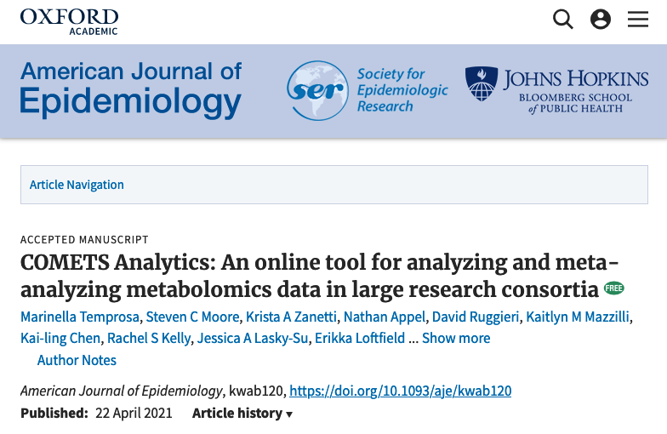
Notes:
The paper is published here

Slide 3
Consortium-based meta-analyses of metabolomic data
Federated Data Analysis
Cohorts evaluate their own data and results are pooled centrally
Used when institutes cannot transfer data (e.g. EU General Data Protection Regulation)
Current Solutions
Code for statistical models sent to each institute
→ requires expert analyst to harmonize data and run models
Software that allows expert analysts to send models to each institute’s data
→ requires data use agreements and hosting of the software on specialized servers
Unmet Needs
Minimize or eliminate data use permissions and consent
Minimize burden on analyst to harmonize data and run models (without errors)
Notes:
Federated data analysis: goal is to minimize movement of data, and original data cannot be reverse engineered from results
DataShield: commands are sent from a central computer to several data analysis computers and datasets can be analyzed in parallel
BioShare project: through workshops/conferences/meetings, harmonization/processing algorithms were shared through an open-source infrastructure.
Secure servers are set up in each study’s host institution and relevant data are loaded onto these servers; a pwd protected web portal federates the servers for analyses.

Slide 4
Our process for federated data analyses
4. Standardized Results Aggregation
1. Standardized Data and Models
(user input)
3. Cohort-specific Analyses with Model Validity Check
2. Input Integrity Check and Harmonization
(automated process)
Goal
To streamline consortium-based analyses of metabolomics data through standardization of data, models, and results.

Slide 5
Overview of Using COMETS Analytics
Temprosa, Moore C.S., et al. AJE 2021

Slide 6
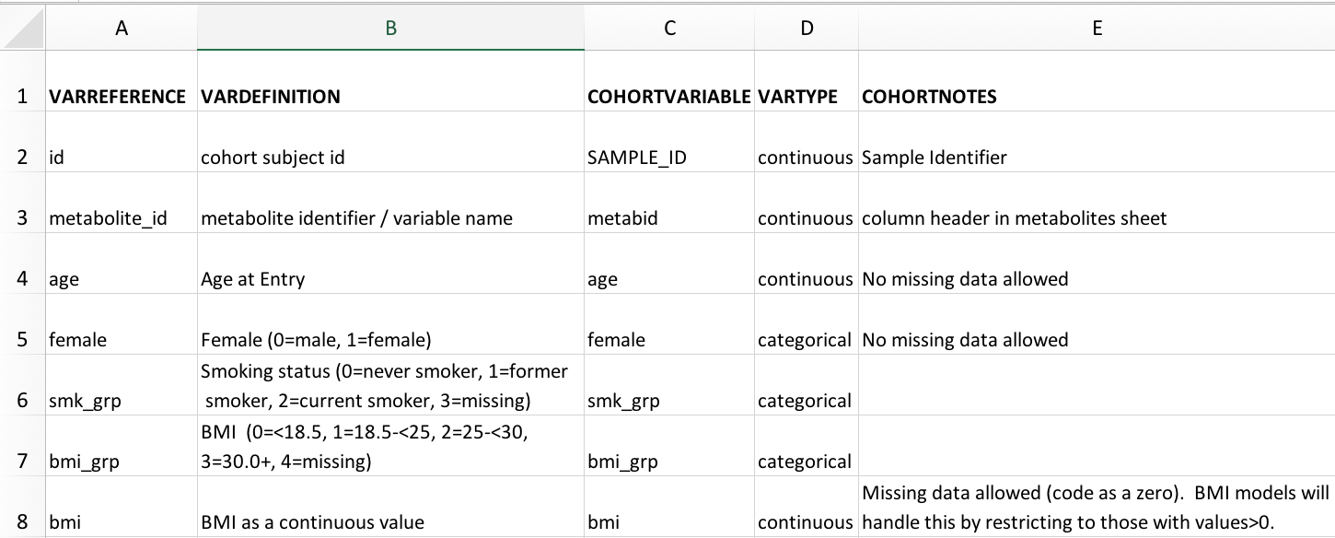
Standardized Input – User Maps Variables to Consortia Variable names and definitions (VarMap)
Variable Names To be Used Across Cohorts (predefined by organizer(s) of meta-analysis)
Detailed Description of how to code variables (predefined)
User variable name (must match Subject Data sheet) and type
Additional Notes
Notes:
Standardize how you would code – change variable map
Main analyst would set this

Slide 7
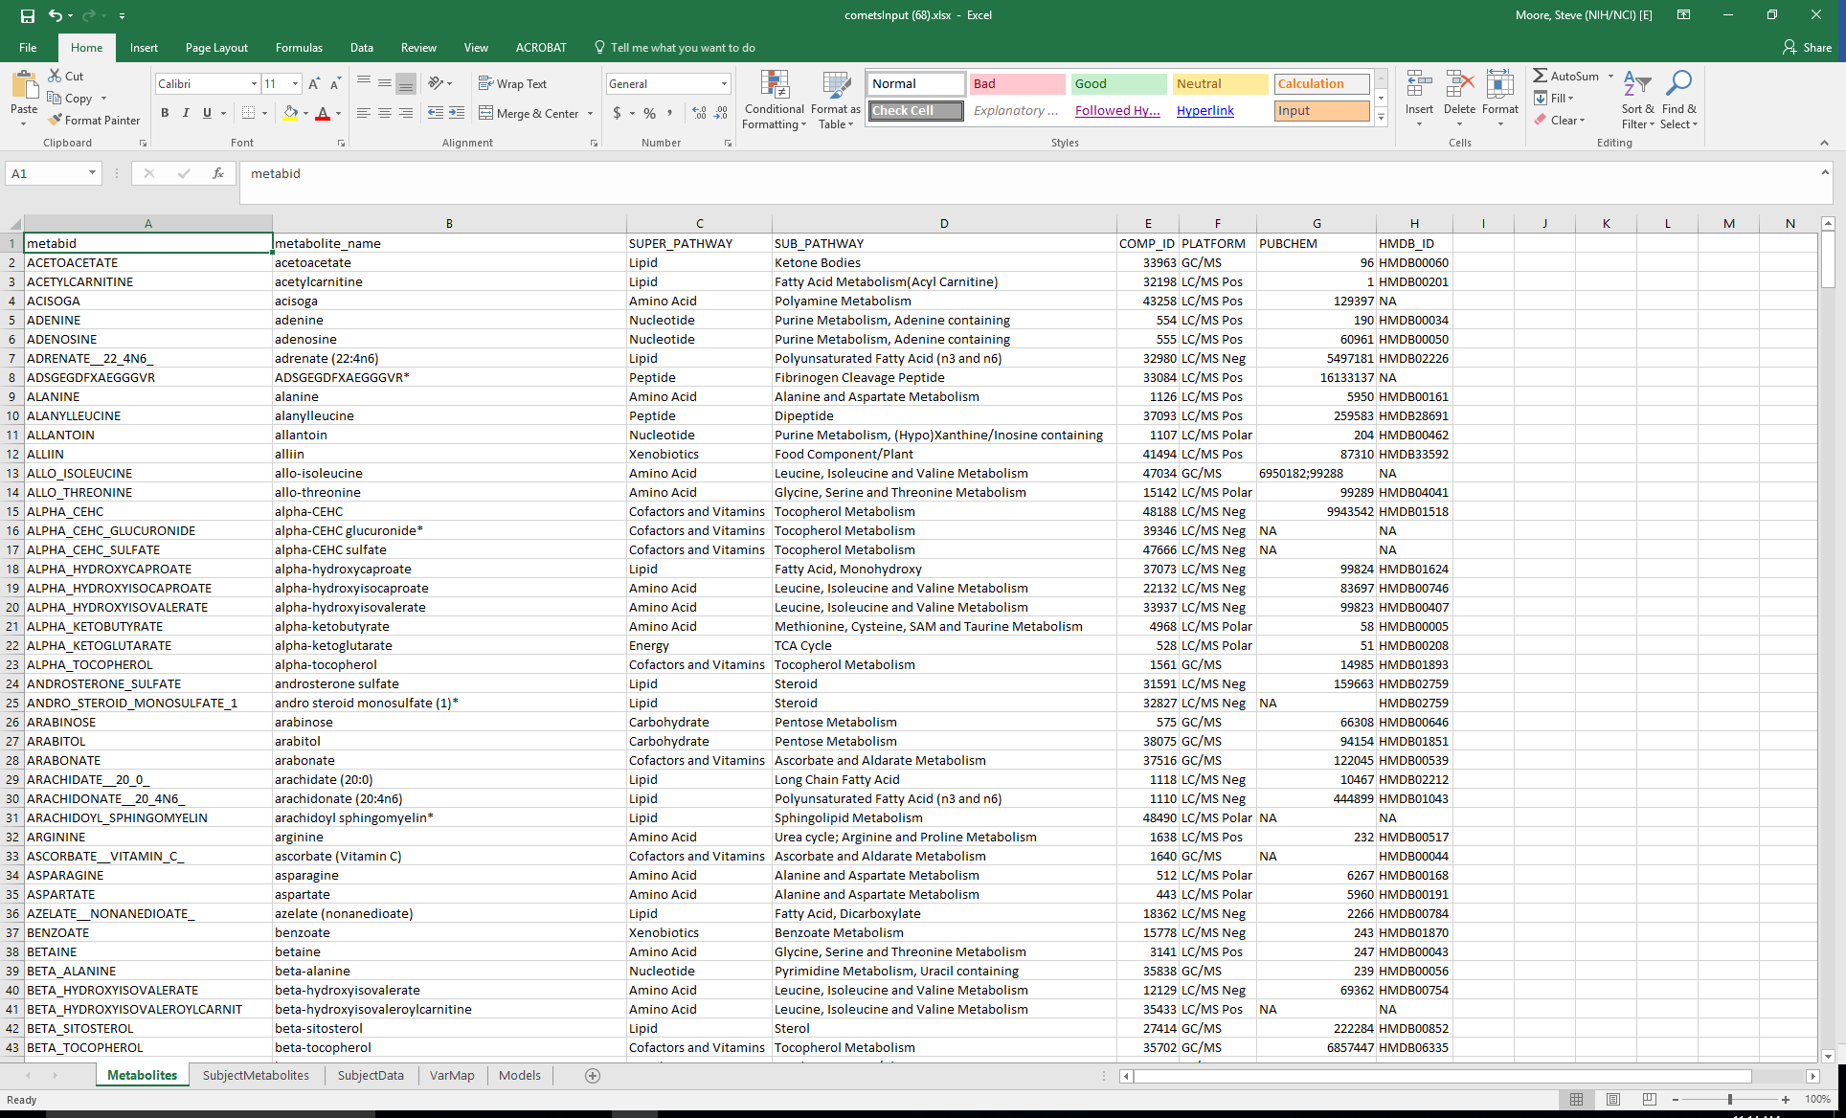
Standardized Input – User Sends Metabolite MetaData Used for Harmonization
metabid | metabolite_name | SUPER_PATHWAY | SUB_PATHWAY | COMP_ID | PLATFORM | HMDB_ID
ACETOACETATE | acetoacetate | Lipid | Ketone Bodies | 33963 | GC/MS | HMDB00060
ACETYLCARNITINE | acetylcarnitine | Lipid | Fatty Acid Metabolism | 32198 | LC/MS Pos | HMDB00201
ACISOGA | acisoga | Amino Acid | Polyamine Metabolism | 43258 | LC/MS Pos | NA
ADENINE | adenine | Nucleotide | Purine Metabolism, Adenine containing | 554 | LC/MS Pos | HMDB00034
ADENOSINE | adenosine | Nucleotide | Purine Metabolism, Adenine containing | 555 | LC/MS Pos | HMDB00050
ADRENATE__22_4N6_ | adrenate (22:4n6) | Lipid | Polyunsaturated Fatty Acid (n3 and n6) | 32980 | LC/MS Neg | HMDB02226
ADSGEGDFXAEGGGVR | ADSGEGDFXAEGGGVR* | Peptide | Fibrinogen Cleavage Peptide | 33084 | LC/MS Pos | NA
ALANINE | alanine | Amino Acid | Alanine and Aspartate Metabolism | 1126 | LC/MS Pos | HMDB00161
ALANYLLEUCINE | alanylleucine | Peptide | Dipeptide | 37093 | LC/MS Pos | HMDB28691
ALLANTOIN | allantoin | Nucleotide | Purine Metabolism, (Hypo)Xanthine/Inosine containing | 1107 | LC/MS Polar | HMDB00462
ALLIIN | alliin | Xenobiotics | Food Component/Plant | 41494 | LC/MS Pos | HMDB33592
ALLO_ISOLEUCINE | allo-isoleucine | Amino Acid | Leucine, Isoleucine and Valine Metabolism | 47034 | GC/MS | NA
Analysis will proceed whether or not all metabolite names are harmonized
Master dictionary contains 4,647 metabolites measured in at least one COMETS cohort
Notes:
Each group sends meta-data provided to them by the lab, then our team links unique identifiers to a master dictionary file that we are building. This creates a mapping of metabolite names that we encounter to a common name…
Harmonization is an iterative process

Slide 8
Standardized Input – Lead Analyst Defines Models
All variables must be predefined in the other sheets
All models can be run in one command

Slide 9
Integrity Checks on Input (Data and Models)
Behind the scenes, only takes a few seconds
Will output a meaningful error when:
Software cannot find appropriate variables (incorrect Variable Mapping sheet)
Metabolites or samples have missing meta data
Models defined are not correct (e.g. adjustment variable is also an outcome variable)
Will output a meaningful warning when:
Variables are appropriately dropped in models (e.g. no variance, etc.)
Models are appropriately dropped (e.g. low sample size, etc.)
Notes:
Title – running with all models without having tweek them

Slide 10
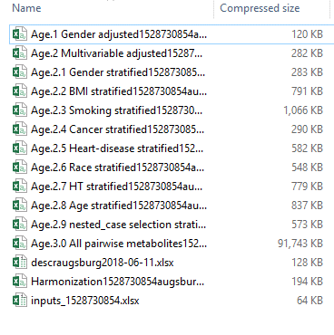
Standardized Output - Results with Warnings
Dear COMETS user, We've finished running your file: cometsInput (63) The results of your batch data run are available through the following link. Any additional information (warnings, errors, etc.) are included below. https://cbiit-tools-results-dev.s3.amazonaws.com/comets/results/Result_cometsInput%20%28.... The search results will be available for the next 7 days. The following models were run and took a total processing time of 239.3 s. Integrity Check Age.1 Gender adjusted - Complete ( Processing time: 31.37 sec ) Warnings: * One of your models specifies female as an adjustment value but that variable only has one possible value. Model will run without female as an adjustment Age.2 Multivariable adjusted - Complete ( Processing time: 5.956 sec ) Warnings: * One of your models specifies female as an adjustment value but that variable only has one possible value. Model will run without female as an adjustment value but that variable only has one possible value. Model will run without fasted as an adjustment…

Slide 11
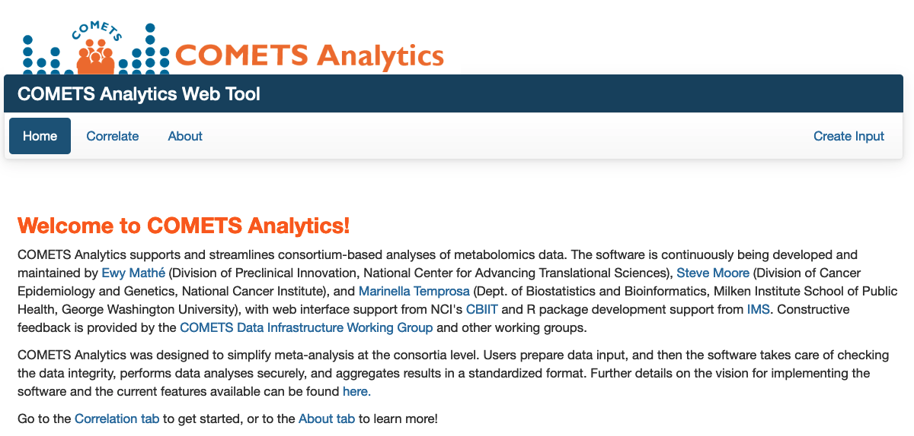
COMETS Analytics Access – Web Interface
User-friendly, requires no coding
Operates on secure cloud-based servers that delete data after analyses
comets-analytics.org

Slide 12
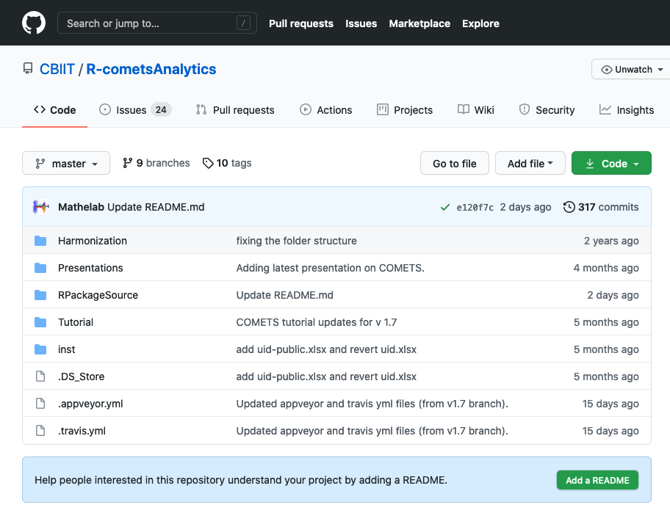
COMETS Analytics Access – R package
Requires minimal knowledge of R/Rstudio to run.
Detailed documentation on how to prepare the input and how to run through an analysis are provided.
By design, using the R package and the user interface will produce the same results!
https://github.com/CBIIT/R-cometsAnalytics

Slide 13
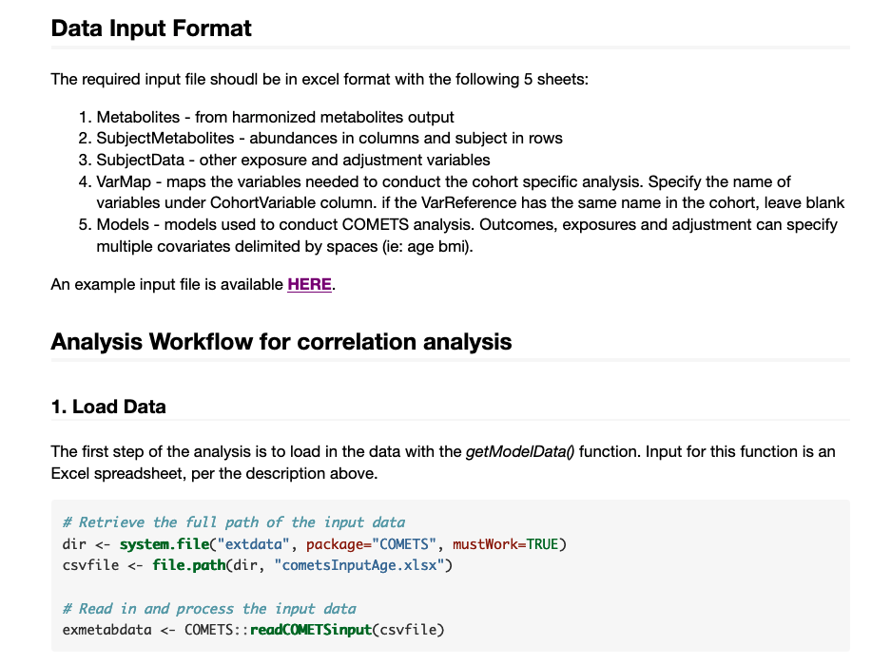
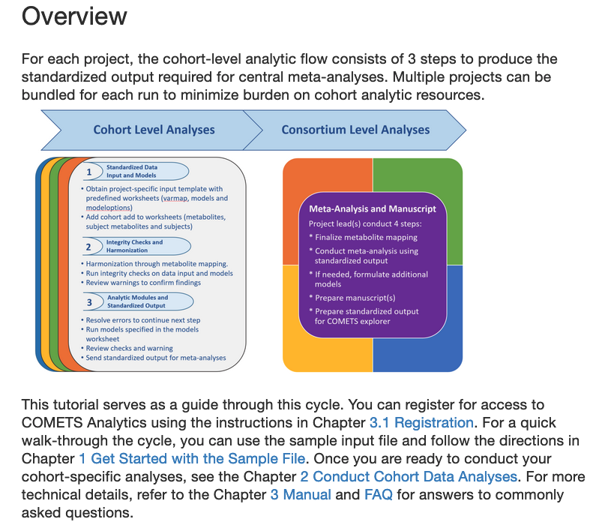
COMETS Analytics – documentation
R package Vignette
Tutorial

Slide 14
Test Application in 45 cohorts
Test Data
Two large scale analyses comprising 45 cohorts
Total of 68 datasets with > 4,500 metabolites measured in > 130,000 individuals across 15 different metabolomics platforms
Testing Criteria
Ability of analysts to prepare data inputs on their own?
→ Minor issues encountered, resolved with consult of trained staff
Correct processing of input files (including models)?
→ All pre-specified models passed on the first try
Notes:
Age and bmi

Slide 15
Upcoming Release Features
Generalized process for running models:
Load Data - readCOMETSinput()
Define model – getModelData()
Run model – runMOdel()
Other models to be supported: generalized linear models, logistic regression, and proportional hazards regression.
Added flexibility in defining model parameters
Default options used by the software or R functions can be overridden by the lead analyst
These options can override one, several, or all models

Slide 16
Considerations for Future Releases
Use of common data models for defining phenotypes and covariables
False negatives could be introduced with the naming harmonization (e.g. variables would not be considered for meta-analyses)
Improving the iterative process (the more data we get, the better!)
Ensuring that COMETS Analytics uses the latest master harmonization file
Expanding annotations of metabolites to include comprehensive pathway mapping
Update and expand functionality based on user feedback

Slide 17
Acknowledgements
See poster # 193 for more info
COMETS Data Infrastructure Group
Steven Moore
Ella Temprosa
Bing Yu
Krista Zanetti
CBIIT web development Team
Kailing Chen
Brian Park
IMS
Dave Ruggieri
Bill Wheeler
Joe Zhu
Funding
EGRP/NCI
NCATS
DCEG Informatics Challenge
Users! Thank you for your feedback!
Temprosa M., Moore S.C., et al. AJE 22 April 2021
Contact us at comets.analytics@gmail.com

Slide 18
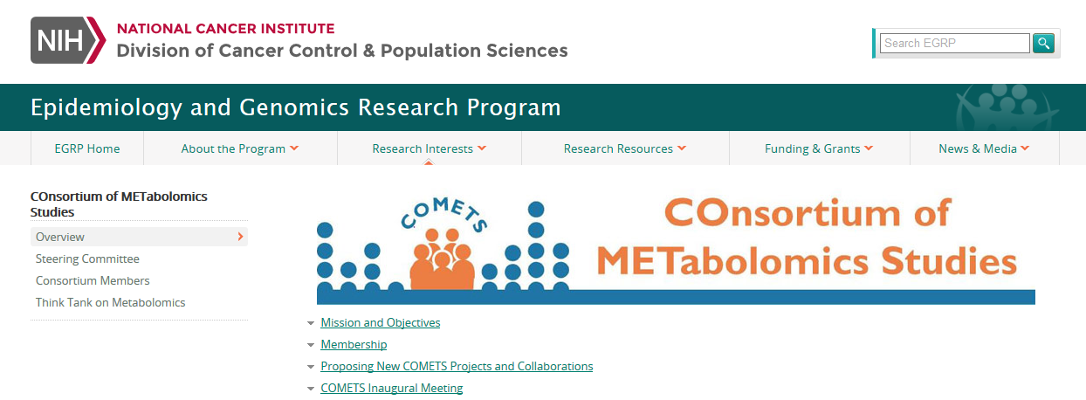
How do I learn more?
Eligibility and current members: https://epi.grants.cancer.gov/comets/
Metabolite list and data-analysis: http://comets-analytics.org/
To inquire about becoming a member, contact Krista Zanetti: zanettik@mail.nih.gov
Notes:
Finally, if you would like to learn more about COMETS, I’ve included these resources. To learn about eligibility criteria and who are the current members..

Slide 19
Sample Data Input

Slide 20
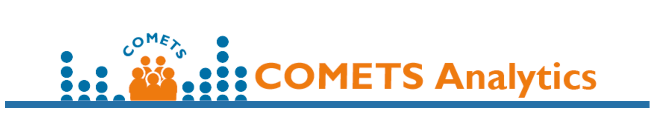
Challenges for consortium-based meta-analyses of metabolomic data
XXX
A way for users to input metadata, ingredients of a working system
Need for experts and non-experts
Make it more hands-on – what can you do with this – how can people participate;
Metabolite name harmonization for common platforms in large epi studies.
→ Would introduce false negatives, not false positives
Reproducibility, usability, input/output consistency

Slide 21
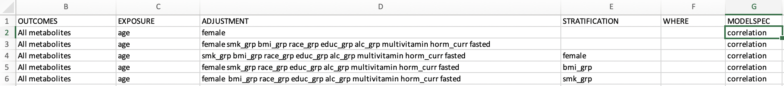
Upcoming Release: Flexibility in Specifying Model Parameters
New ”MODELSPEC” column: can create a specific name for the model, allowing users to change parameters for that model specifically
The name in “MODELSPEC” column for a model in this sheet then matches the name of “MODELSPEC” for rows in the ModelOptions Sheet.

Slide 22
COMETS Analytics
Goal
To streamline consortium-based analyses of metabolomics data through standardization of data, models, and results.
Design Considerations:
High usability (by expert and non-expert analysts) and accessibility
Data protection
Follows best practices for coding and algorithm development
Standardized data inputs and models
Standardized and well documented results
Applicable to other omic data
Can be run locally (e.g. R package) or through a web app
Reproducibility, usability, input/output consistency

Slide 23
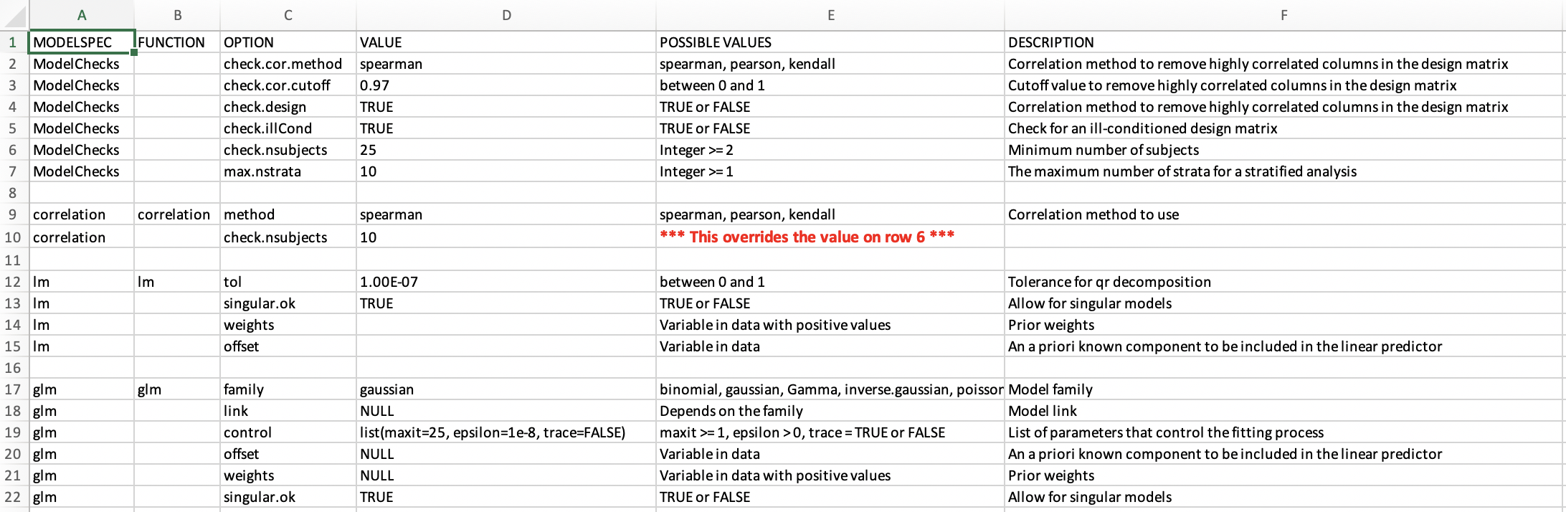
Upcoming Release: Flexibility in Parameters That Apply to All Models
Default options used by the software can be overridden by the lead analyst
Options can be overridden for a specific model

Slide 24
Upcoming Release: Flexibility in Parameters That Apply to Specific Models
Minimum number of subjects is overridden for ”correlation” models only.

Slide 25
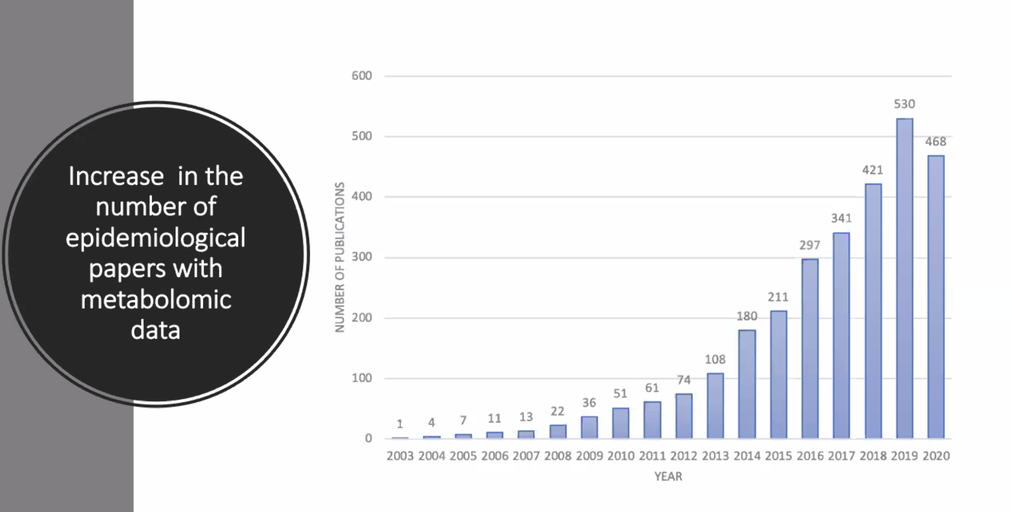

Slide 26
Feedback from session:
Include multivariate analyses (PCA< PLS-da, ML< etc.)
Include metrics for biomarker studies

